Slide 1

DTCC AI Hackathon
Presentation
Team id: 7064-53
Date: 2025-10-16

Slide 2
Our team
Vyas Pavoori
Advithiyasiri (Siri) Kolahalam
Tianai Zhao
EDCT CLAW
University of North Texas
EDCT CLAW

Slide 3
AI-Powered Automation Deployment
Use Case Name:
THE PROBLEM
Manual deployment workflows slow development velocity. Human error in repetitive deployment tasks.
Large development team.
Dependency on team members with experience/knowledge on deployment.
No automated analysis of code changes and their impact. Limited visibility into deployment risks before execution.
Deployment logs scattered across multiple systems.

Slide 4
Solution Overview
Deployment workflow triggered once changes merged into QA branch.
Manual packaging when requested
Rely on DEV testing
Additional layer of control provided by LLM agent risk assessments and insights.
Metadata scatter across Bitbucket, Jenkins, Snowflake…
Orchestrated by agentic AI. All related log data centralized and stored.

Slide 5
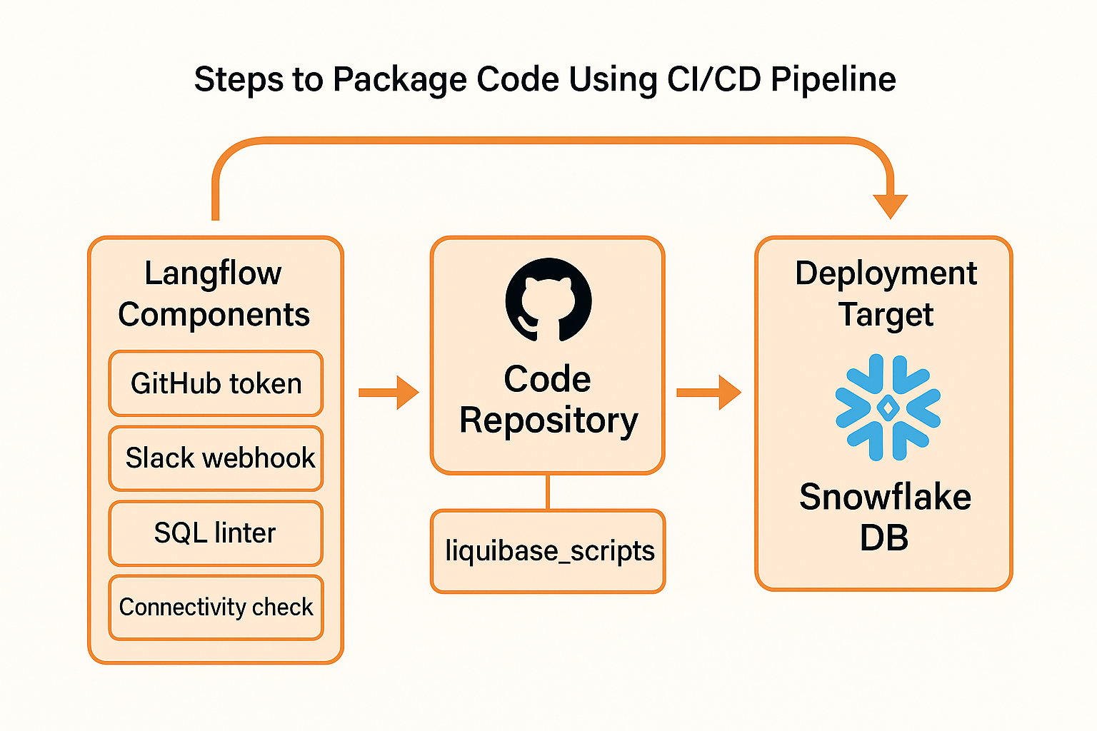
Implementation

Slide 6
Alternative
-– n8n workflow trigger by Webhook and execute in snowflake

Slide 7
Model enhancement &
Potential path to production
Integration with DTCC system
Configure Webhook on Bitbucket branch
Data enrichment and Prompt engineering for agent
Make use of past deployment failure or defect code. Make risk analysis more robust.

Slide 8
Limitations and lessons learned
Hands on technical skills
Docker build
Workflow orchestration
AWS Codecommit not mapping to Github

Slide 9
Thank you
Questions?

